Slide 1
Foreign Exchange Market Directionality Prediction
Predict directionality of currency - USD
Project Team Members
Notes:
Hello everyone, my project is about predicting directionality of USD on the foreign exchange marke today. I wil introduce them from several parts.

Slide 2
Project Purpose
Problem
Prepare history data and predict the directionality using machine-learning algorithm regression and classification.
Value proposition solved
Predict the concurrency trend on market
Monitor the status on concurrency fluctuation
Notes:
As the slides says, I use machine learning knowledge and model to predict the concurrency trend on foreign market and
The project can also help monitor the status on concurrency fluctuation . The following is the data.

Slide 3
Analytic Approach
Data Preparation
Features :
Average Bid in one hour
The difference between maximum and minimum bid
Average of spread(ask - bid)/ask in one hour
The average ask in previous one hour
Data Set
From 2014 Feb to 2015 May
80% is train data set , 20 % is test data set.
Label :
Directionality : 1 is increasing , -1 is decreasing
Notes:
You must curious about the meaning of bid, ask ,and spread. The ask is the offer price and the bid is the accepted price.
All data is from the dataset from 2014 Feb to 2015 May . I took 80% of them as training data and 20 % of them as training data. I extract four attributes, the average bid, difference between max and min bid, the average of spread, and the average ask . The Label, also what we want , is the directionality, 1 indicates increasing , -1 indicates decreasing.

Slide 4
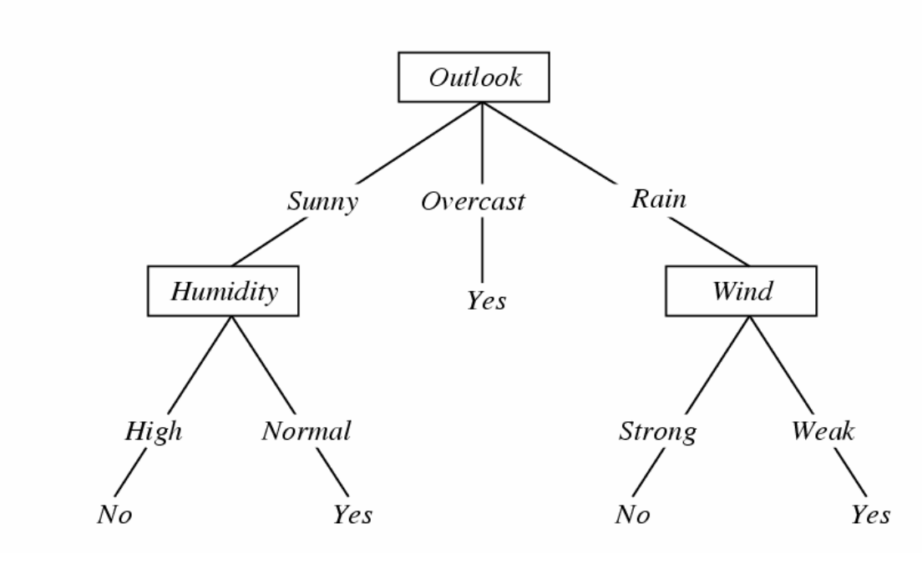
Decision Tree
Example
Each internal node : test one attribute Xi , chose by Information Gain value
Each branch : select one value for Xi
Each leaf node : predict Y (P(Y|X is leaf))
Notes:
Explain the general meaning of decision tree in the picture.Then, map the picture to my project attributes to make audience understand it well. For every level , why I choose this attribute instead of other. That is because information gain, which contains most dividing info in this level.

Slide 5
Random Forest
Take 2 attributes randomly
With 2/3 training random data each time to generate several decision trees.
Have the value on each decision tree and get the majority as the final decision
Notes:
As for random forest, I choose sqrt of m, m here is 4 , and 2/3 of data each time to generate the decision tree separately. We will get separate value from each decision tree. How do we make sure what is the final decision? So , I take the majority of the value. For example, 60% is 1, and 40% trees is 1, so I take the final value is 1.

Slide 6
Explore tech tools
Map Reduce to shuffle data
No-SQL : Cassandra to store data
Spark , Scala and Mllib to generate random forest trees
Notes:
I also explore and learnt several tools and technologies in this project. Using Map Reduce to shuffle data and store the data, mapper function to get the same key word and reducer get the count by the key word. The write and read the date from the no-SQL database Cassandra. Also implementation Scala with Saprk an using ML libray to generate random forest automatically.

Slide 7
Results
Performance
Approach Method | Test Accuracy
Decision Tree | 50.1523%
Random Forest(All trees finished) | 50.2%
Random Forest (Map Reduce) | 50.2%
Random Forest (Spark Scala Mllib ) | 50.120%
Notes:
As result show above , we can see the test accuracy wit different models and different tools. They are almost same, and on random forest case, The analysis in on the next slide (flip)

Slide 8
Results
Result Analysis
In the Random Forest Tree, more tree numbers the accuracy is more stable.
The random forest method accuracy is slightly better than decision tree in my case
Saprk Mllib help a lot on generating but the result is not such much better.
MapReduce distributed generating data, speed the result fetching.
Notes:
As the slides explained that, the random forest trees number effecting the accuracy of the result in my project, but not such much difference. So I give the final result in last slide. Using random forest method is better than the single decision tree. And Using Map Reduce and Spark Mllib seems do not sharpen the result but gave quicker data extract load and transform process.

Slide 9
Error Analysis
More features in the model
Other kind of concurrency to USD: ERU-USD
Smaller time slot
Check whether the accuracy will be better if get sample every 1s instead of 1h
Other factors need to be considered
The country policy, bank effects
Notes:
We can see from the slide that , the project is far from perfect. We need to consider more features and try smaller time slots to compare the accuracy .

Slide 10
Actionable Information or Insights
The results message can indicates the fluctuation in general to the stakeholders.
The stakeholder can used this as based data, and use other model to detect it and predict more longer trend
If the trend is stably increasing, then can make decision to buy more stock
Notes:
For the practical usage of the project , the stakeholder can use this result and data as basic idea and explore more suitable models on it. Or they can decide to buy more stocks when the trend is good , otherwise drop some of them.

Slide 11
Challenges
Many other factors should be considered into
The predication is not completed, other features in financial may be better attributes in this model , but ignore this time.
Noise in data and may disturb the result
Also need avoid over fitting

Slide 12
Learn From the Project
Predict Future ! Using machine learning model to predict future using history , decision tree, random forest, MLlib
Obtaining suitable features extract and feature extracting and suitable data prepare method
Technologies and tools to ELT and analysis result, such as map reduce, spark, etc.
Notes:
This page is about what I learnt from the project. We can predict future using past data. Exciting ? I also obtain experience on choosing features and prepare data. Also , learnt the several classifiers ,decision tree, random forest tree, mllib and have chance to touch different tech , spark, map reduce. Enlarge my tech horizon.

Slide 13
Future Work
Explore more technologies or library to train the model better and get better accuracy
Putting estimators, transformer of the features with more factors adding
Next Project may be about the using other classifier like SVM, python-learn or other lib.
Notes:
The project is not stop here. We can do more on it. We can explore more technologies or library to train the model better and get better accuracy. Using estimators, transformer of the features with more factors adding. We can also learn more about other classifiers, svm, python –learn, etc.

Slide 14
Supplemental Information
The advantage and disadvantages of using Cassandra, Map Reduce , Saprk Mllib separately
How to choose tools and technologies in different cases to get better result than using other.
Notes:
For the importance on further research, I will introduce them with the advantage and disadvantage disadvantages of using Cassandra, Map Reduce , Saprk Mllib separately. We also need to know how to choose tools and technologies in different cases to get better result than using other.

Slide 15
Reference
https://en.wikipedia.org/wiki/Decision_tree_learning
https://en.wikipedia.org/wiki/Random_forest
Notes:
Here is references.s

Slide 16
Thanks !
Notes:
Thanks for listening !

